Slide 1



DAHEL TECHIES
SQL
By Modinat Ganiyu

Slide 2
SQL QUERY
A query in the context of database is a request made to the database to perform a specific action on the data. This action can include retrieving data, inserting new data, updating existing data, or deleting data. SQL queries enable users to interact with the database, asking it to execute operations and return results based on the specified criteria.
Example of a Simple Query:
CREATE DATABASE companydata;
USE companydata;

Slide 3
SQL DATA TYPES
Numeric Data Types
•INTEGER (INT): Stores whole numbers without decimals.
•SMALLINT: Stores smaller whole numbers. It occupies less space and has a smaller range than INTEGER.
•BIGINT: For very large whole numbers. It has a larger range than INTEGER.
•DECIMAL (DEC, NUMERIC): Fixed precision and scale numbers. You can specify the maximum number of digits and the number of digits after the decimal point.
•FLOAT, DOUBLE: Floating-point numbers. DOUBLE has more precision than FLOAT.
•REAL: Another type for floating-point numbers, with implementation-specific precision.

Slide 4
SQL DATA TYPES
String Data Types:
•CHAR (CHARACTER): Fixed-length string. Spaces are added to fit the defined length if the stored string is shorter.
•VARCHAR (CHARACTER VARYING): Variable-length string. It stores strings up to a specified length.
Date and Time Data Types
•DATE: Stores a date (year, month, and day).
•TIME: Stores a time (hours, minutes, seconds, and fractions of a second).
•DATETIME: Combines DATE and TIME, stores both date and time.
•TIMESTAMP: Like DATETIME, but also includes timezone information in some databases.

Slide 5

SQL DATA TYPES
Binary Data Types
•BINARY: Stores binary data (byte sequences) with a fixed length.
•VARBINARY: Stores binary data with a variable length.
•BLOB (Binary Large Object): For storing very large binary data such as images or multimedia files.
Boolean Data Type
•BOOLEAN (BOOL): Stores TRUE or FALSE values

Slide 6
The Principles of SQL Syntax
Clarity and Readability
SQL syntax is designed to be somewhat intuitive and readable, almost like structured English. This design aims to make it easier to understand what a query or command does at a glance.
For example, SELECT * FROM users WHERE age > 18; is straightforward—it selects all records from the users table where the age is greater than 18.
SQL Keywords
SQL statements are built using keywords that are predefined by the SQL standard and specific SQL dialects. These keywords are not case-sensitive, but it's a common practice to write them in uppercase to distinguish them from table and column names, improving readability.
Examples include: SELECT, INSERT, UPDATE, DELETE, FROM, WHERE, HAVING, JOIN, CREATE, ALTER, and DROP.

Slide 7
The Principles of SQL Syntax
Semicolons as Statement Terminators
Semicolons (;) are used to mark the end of an SQL statement. In scripts with multiple statements or when working on certain SQL database systems, semicolons are necessary to differentiate between statements.
Comments for Explanation
SQL supports comments to allow explanations and annotations within the code. Single-line comments start with --, and multi-line comments are enclosed between /* and */. Comments are ignored by the SQL engine.

Slide 8
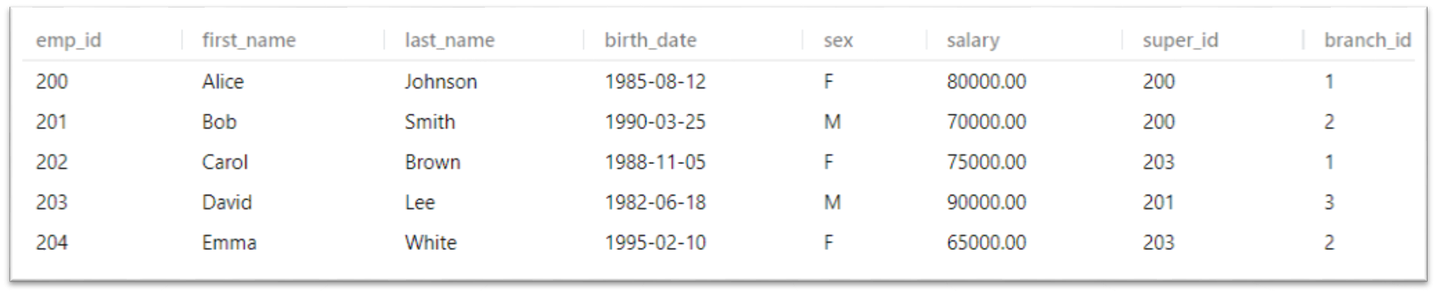
--create employee table
CREATE TABLE employee(
emp_id INT PRIMARY KEY, first_name VARCHAR(30), last_name VARCHAR(30),
birth_date DATE, sex CHAR(7), salary Bigint,
super_id INT, branch_id INT
);
-- Select * from employee
-- Inserting values
INSERT INTO employee VALUES
(200, 'Alice', 'Johnson', '1985-08-12', 'F', 80000, 200, 1),

Slide 9
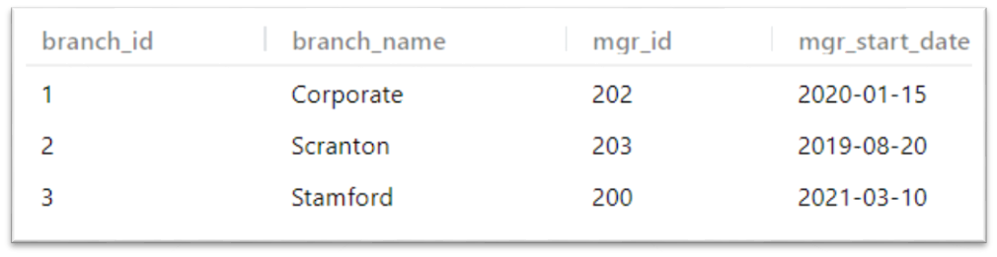
-- Creating branch table
CREATE TABLE branch(
branch_id INT PRIMARY KEY,
branch_name VARCHAR (20),
mgr_id INT,
mgr_start_date DATE
);
-- Inserting data into table Branch
INSERT INTO branch VALUES
(1, 'Corporate', 100, '2020-01-15'),

Slide 10
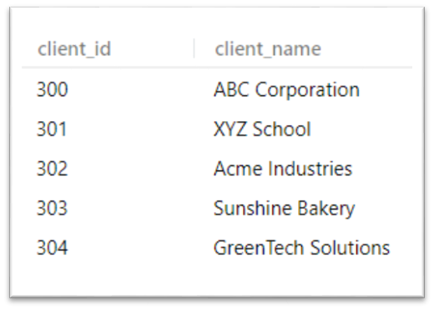
-- Creating table for Client
CREATE TABLE client(
client_id INT PRIMARY KEY,
client_name VARCHAR(20)
);
-- Inserting data for Clients
INSERT INTO client VALUES
(300, 'ABC Corporation'),
(301, 'XYZ School'),

Slide 11
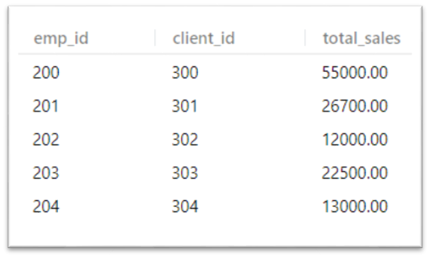
-- Creating Table for Works_with
CREATE TABLE works_with(
emp_id INT ,
client_id INT,
total_sales DECIMAL(10, 2),
PRIMARY KEY (emp_id, client_id)
);
-- Inserting data for works_with
INSERT INTO works_with (emp_id, client_id, total_sales)
VALUES
(200, 300, 55000),

Slide 12
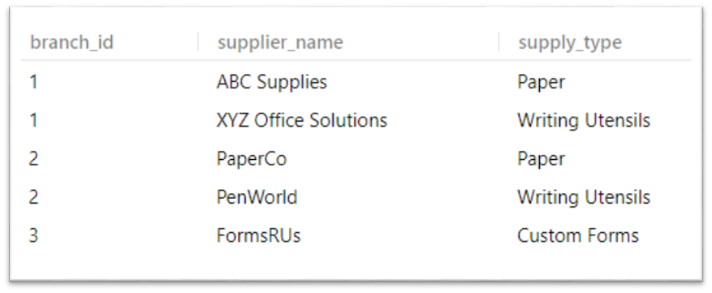
-- Creating table branch_supplier
CREATE TABLE branch_supplier(
branch_id INT,
supplier_name VARCHAR(50),
supply_type VARCHAR (20),
PRIMARY KEY (branch_id, supplier_name),
FOREIGN KEY (branch_id) REFERENCES branch(branch_id)
);
INSERT INTO branch_supplier VALUES
(1, 'ABC Supplies', 'Paper'),
(1, 'XYZ Office Solutions', 'Writing Utensils'),
(2, 'PaperCo', 'Paper'),
(2, 'PenWorld', 'Writing Utensils'),
(3, 'FormsRUs', 'Custom Forms');

Slide 13
Keys:
In relational databases, keys are critical for establishing relationships between tables and ensuring the integrity and efficient access of data. Keys help to uniquely identify rows (records) in a table and create links between tables. Here are the primary types of keys used in relational databases:
Primary Key
Description: A primary key is a column (or a set of columns) that uniquely identifies each row in a table.
A table can have only one primary key, and it cannot contain null values, ensuring that every record can be uniquely identified.
Purpose: To uniquely identify each record in a table.
Foreign Key
Description: A foreign key is a column (or set of columns) in one table that references the primary key of another table.
The purpose of the foreign key is to enforce referential integrity between two tables.
Purpose: To create and enforce a link between the data in two tables, ensuring the consistency of relationships.
Composite Key
Description: A composite key is made up of two or more columns used together as a primary key to uniquely identify rows in a table. This is used when no single column uniquely identifies records within the table.
Purpose: To uniquely identify records in a table where a single column is not sufficient.

Slide 14
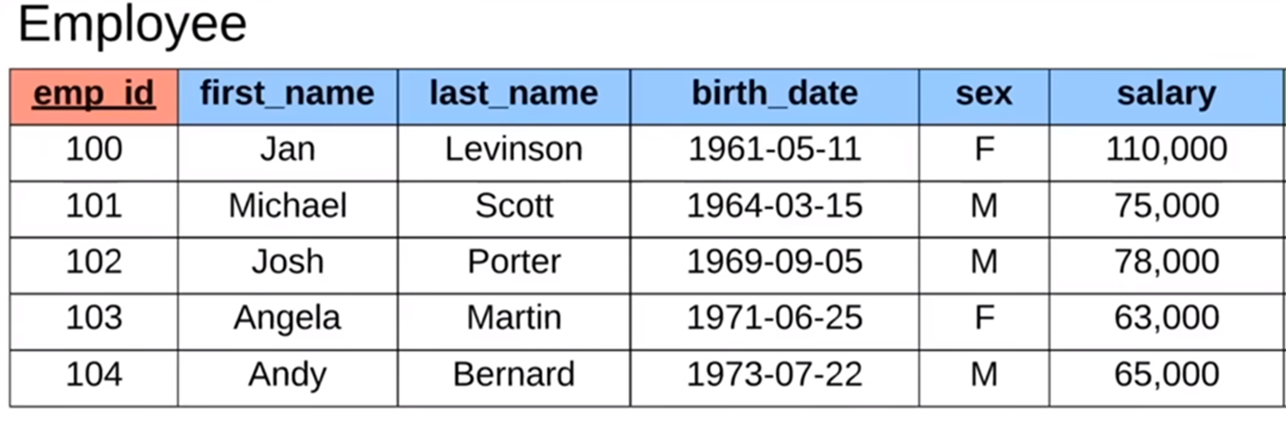

Slide 15
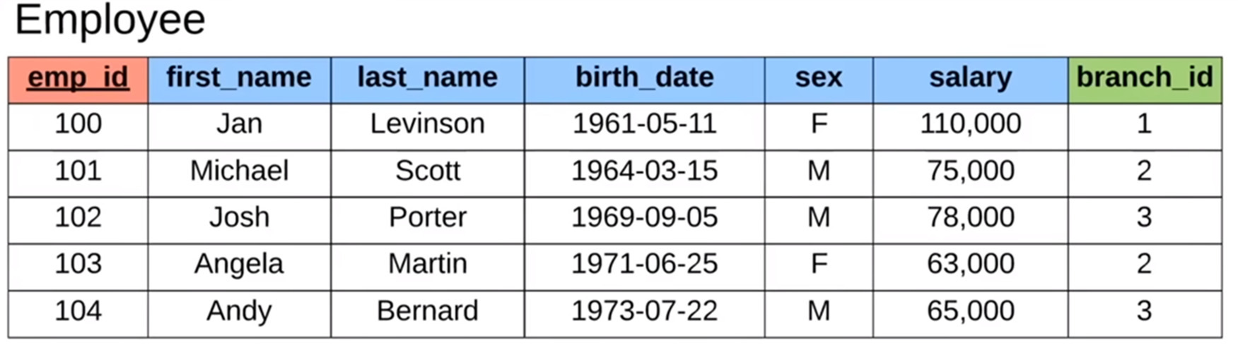
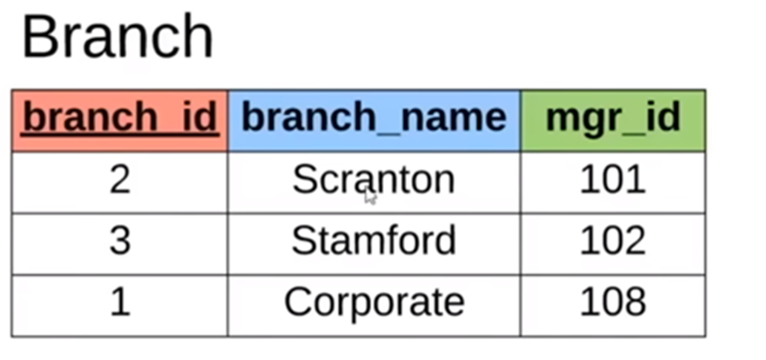

Slide 16
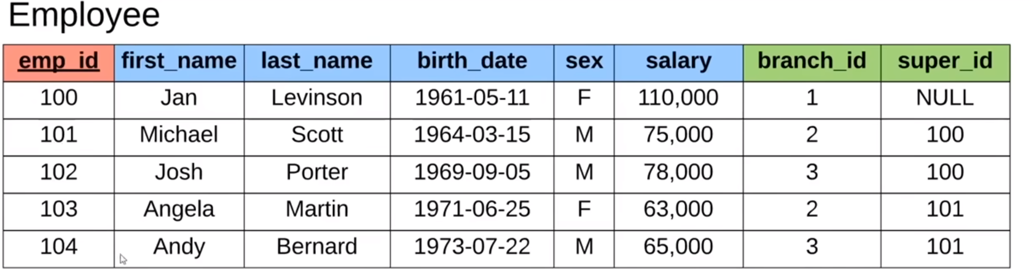
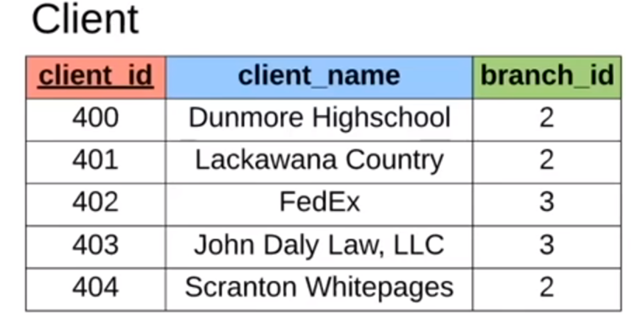

Slide 17
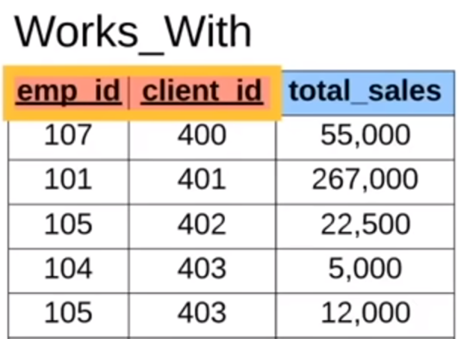

Slide 18
Query the dataset
-- Find all clients
-- Find all employees ordered by salary
-- Find all employees ordered by sex then name
-- Find the first 5 employees in the table
-- Find the first and last names of all employees
-- Find the forename and surnames names of all employees
-- Find out all the different genders
-- Find all male employees
-- Find all employees at branch 2
-- Find all employee's id's and names who were born after 1969
-- Find all female employees at branch 2
-- Find all employees who are female & born after 1969 or who make over 80000
-- Find all employees born between 1970 and 1975
-- Find all employees named Jim, Michael, Johnny or David

Slide 19


